Slide 1
Additional E-R Concepts
扩充的内容
  IS_A联系
    Generalization Hierarchies
  弱实体(Weak Entity)
  属性的划分
  Cardinality of Entity Participation in a Relationship

Slide 2
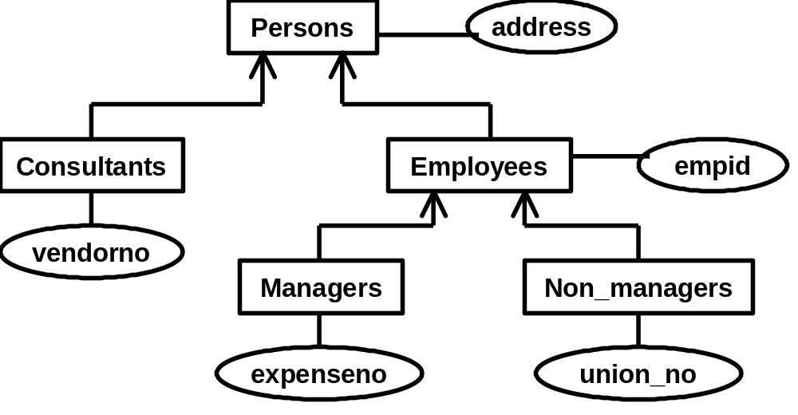
Additional E-R Concepts
IS_A (Generalization Hierarchies)

Slide 3
Additional E-R Concepts
Weak Entities
  A weak entity is an entity whose occurrences are dependent for their existence, through a relationship R, on the occurrence of another (strong) entity.
  example (next slide)

Slide 4
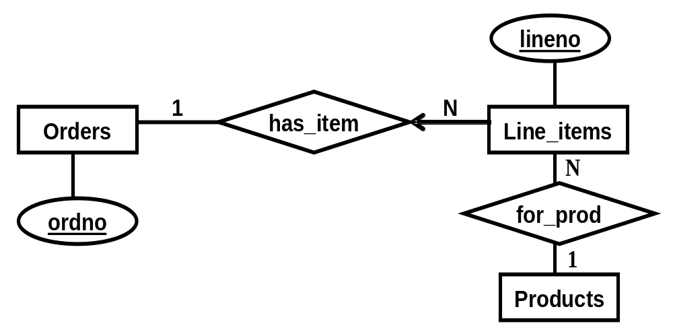
Additional E-R Concepts
Line_items is a weak entity through relationship has_item

Slide 5
Additional E-R Concepts
属性的划分
  Identifier
    candidate key (候选键)
    primary identifier (主键)
  Descriptor
  a composite attribute
    a group of simple attributes that together describe a property
  a multi-valued attribute
    can take on multiple values for a single entity instance.

Slide 6
sid
Students
student_name
lname
fname
midinitial
Fig. a composite attribute ‘student_name’

Slide 7
eid
hobbies
Employees
emp_address
staddress
city
state
Fig. a multi-valued attribute ‘hobbies’

Slide 8
Additional E-R Concepts
Cardinality of Attributes: (x, y)
  (0, ?) means don't have to say not null (optional)
    midinitial, emp_address
  (1, ?) means do (mandatory)
    sid, student_name, lname, fname, city, ......
  (?, 1) single valued attribute
    sid, eid
  (?, N) multi-valued
    hobbies

Slide 9
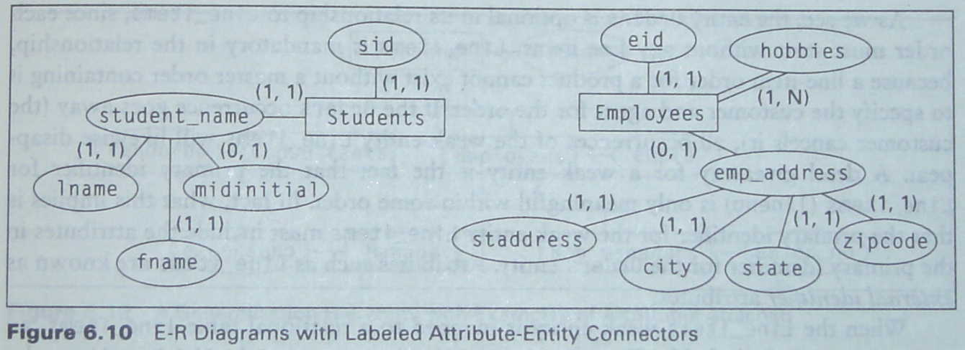
Additional E-R Concepts

Slide 10
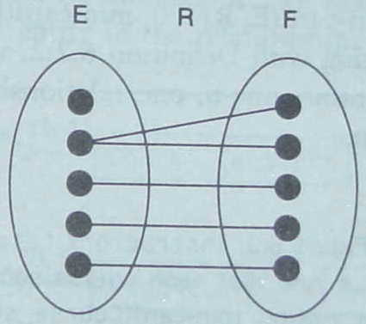
Additional E-R Concepts
Cardinality of Entity Participation in a Relationship
  Look at Figure (below)
    Entities E and F, relationship R.
    Lines between dots.
      Dots are entity instances.
      Lines are relationship instances.

Slide 11
Additional E-R Concepts
Def. 1.1 max-card(E, R)
  If all dots in the entity E have AT MOST one line coming out, we say: max-card(E, R) = 1
  If more than one line out is possible, we say: max-card(E, R) = N
Example:
max-card(E,R)=?
max-card(E,R)=N
max-card(F,R)=?
max-card(F,R)=1

Slide 12
Additional E-R Concepts
Def. 1.2 min-card(E, R)
  If all dots in the entity E have AT LEAST one line coming out, we say: min-card(E, R) = 1
  If some dots might not have a line coming out, we say: min-card(E, R) = 0
Example:
min-card(E,R)=?
min-card(E,R)=0
min-card(F,R)=?
min-card(F,R)=1

Slide 13
Additional E-R Concepts
Def. 1.3 Card(E, R)
  We combine these, by saying card(E, R) = (x, y) if min-card(E, R) = x and max-card(E, R) = y
    x is either 0 or 1, and y is either 1 or N
card(E, R) = (0, N)
card(F, R) = (1, 1)

Slide 14
Examples of E-R Diagrams
[Example one]
Instructors
(0, N)
Teachs
(1, 1)
Course_sections
[Example two]
Employees
(1, N)
works_on
(0, N)
Projects
percent

Slide 15
Examples of E-R Diagrams
[Example three]
(0, N)
manager_of
Employees
manages
reports_to
(0, 1)

Slide 16
Additional E-R Concepts
manager-of
reports-to
Manages
Emps_One
Emps_Two
(0, N)
(0, 1)
Employee in Emps_One is a manager of Employee in Emps_Two.

Slide 17
Additional E-R Concepts
Def 1.4
  if max-card(X, R) = 1 then X is said to have single-valued participation(单值参与) in the relationship R.
  If max-card(X, R) = N, then X is said to be multi-valued participation（多值参与） in this relationship.

Slide 18
Additional E-R Concepts
Def 1.5
  If min-card(X, R) = 1, X is said to have mandatory participation（强制参与） in the relationship R
  if min-card(X, R) = 0, then optional participation（可选参与）

Slide 19
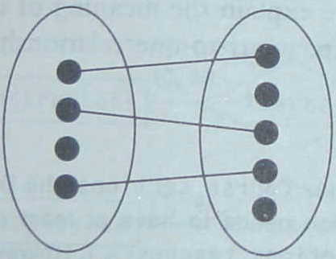
Additional E-R Concepts
One-to-One, Many-to-Many, and Many-to-One Relationship
  One-to-One (1-1) relationship
    both entities are single-valued in the relationship (max-card concept only)
E
R
F

Slide 20
Additional E-R Concepts
One-to-One, Many-to-Many, and Many-to-One Relationship
  Many-to-One (N-1)
    one entity is multi-valued and one is single valued

Slide 21
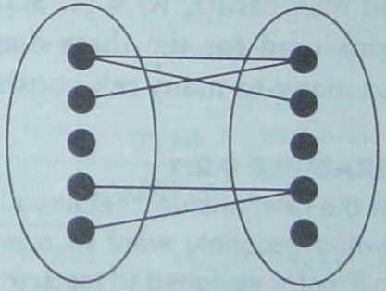
Additional E-R Concepts
One-to-One, Many-to-Many, and Many-to-One Relationship
  Many-to-Many (N-N)
    both entities are multi-valued
E
R
F

